Slide 1
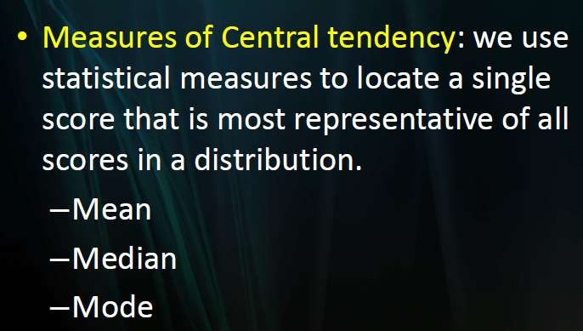
DESCRIPTIVE Statistics: Measure of central tendency

Slide 2
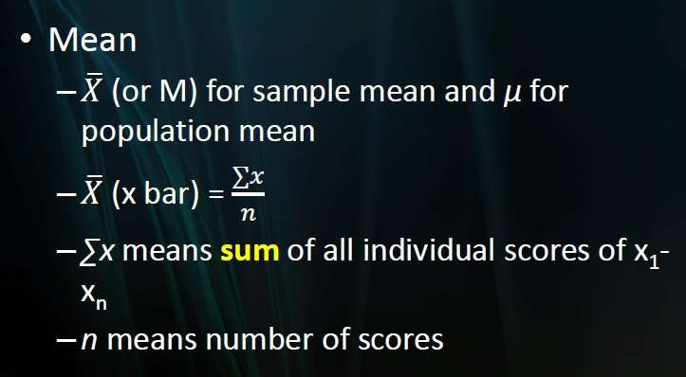
Measure of central tendency

Slide 3
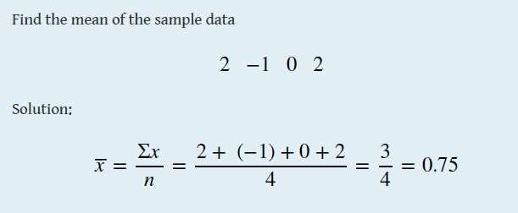

Slide 4
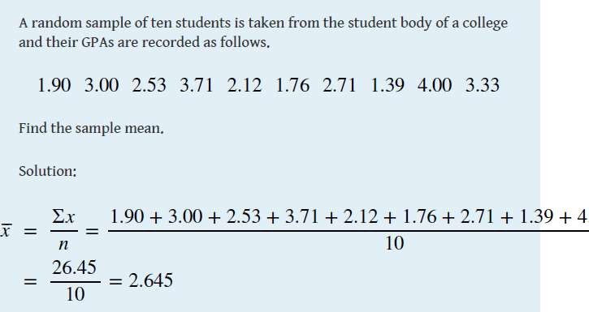

Slide 5
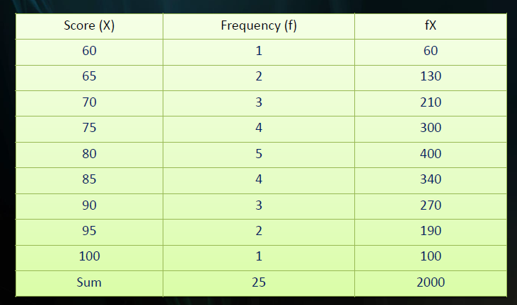

Slide 6
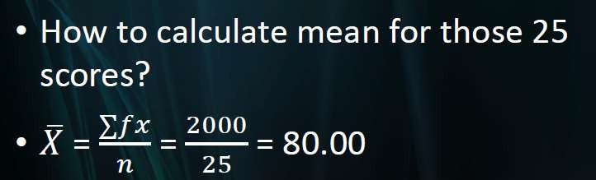

Slide 7
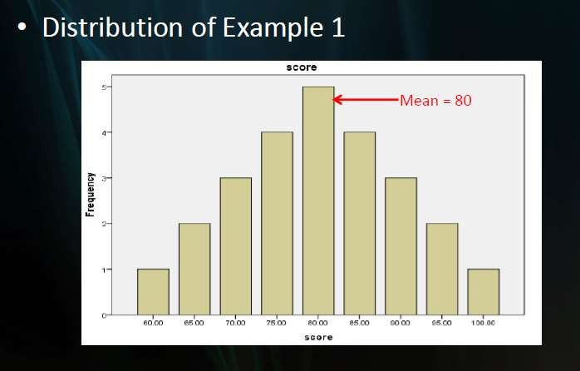

Slide 8
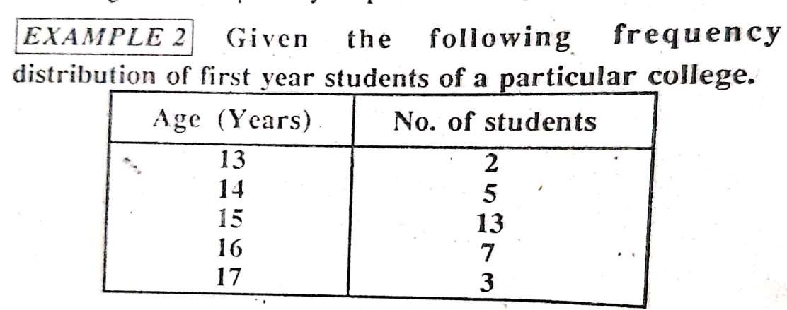

Slide 9
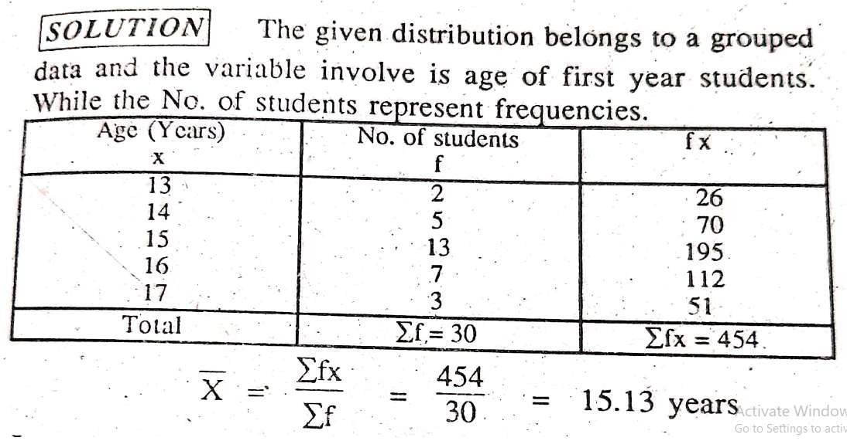

Slide 10
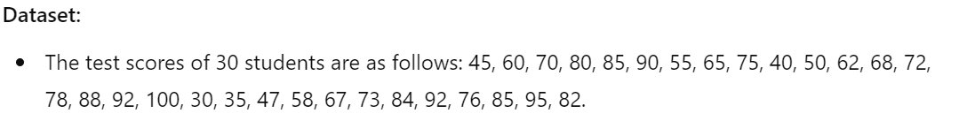
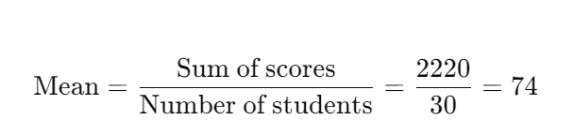
Scenario: Analyzing Test Scores in a School
A high school teacher wants to understand the overall performance of students in a mathematics exam to identify trends in class performance. The teacher has recorded the scores of 30 students and wants to compute the mean score to analyze whether the class performed well as a whole.

Slide 11
The mean score of the class is 74. This indicates that, on average, students performed reasonably well on the exam. However, the mean alone does not provide the entire picture, as it does not capture the spread of the data or how individual students performed relative to each other.

Slide 12
Limitations of the Mean
While the mean provides a quick summary of the data, it is sensitive to extreme values (outliers). For example, if one student had an unusually low score (e.g., 10), the mean would decrease significantly, even though most students performed around the average. To understand the distribution of scores, it may be necessary to calculate other statistics like the median, mode, or standard deviation.

Slide 13
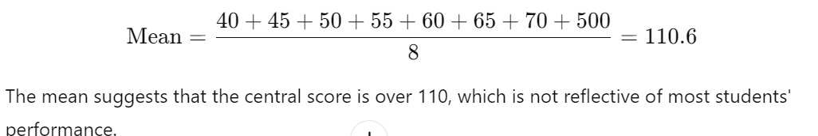
1. Sensitivity to Outliers:
Mean: The mean is sensitive to extreme values (outliers). A single very large or very small value can significantly affect the mean, pulling it in the direction of the outlier and providing a misleading sense of the dataset's central tendency.
Example: Consider the test scores: 40, 45, 50, 55, 60, 65, 70, 500. The mean would be pulled up because of the 500, even though most of the data points are much lower.

Slide 14
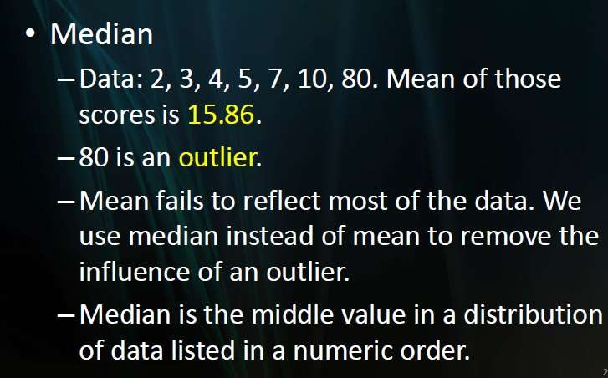

Slide 15
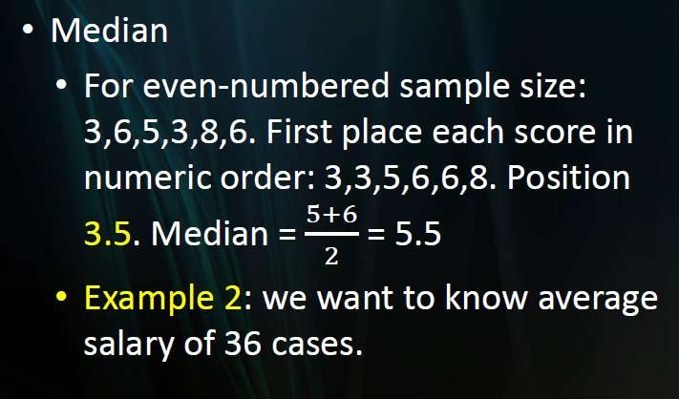

Slide 16
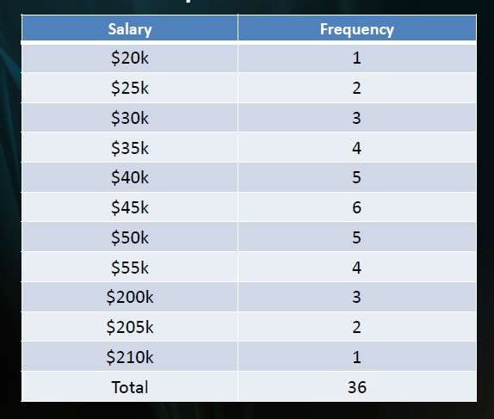

Slide 17
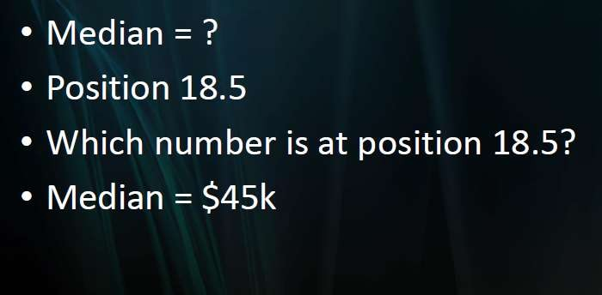

Slide 18
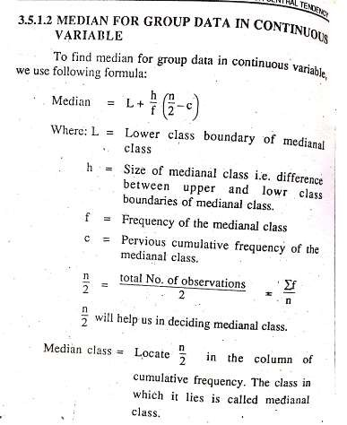

Slide 19
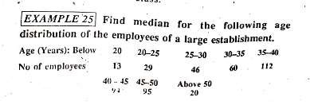

Slide 20
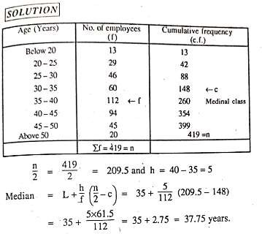

Slide 21
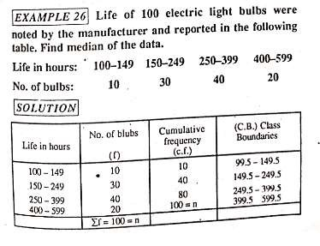

Slide 22
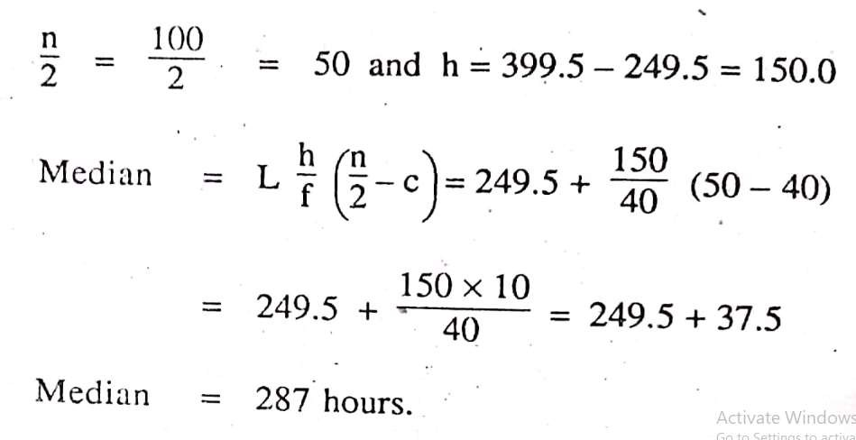

Slide 23
Mode is the most appropriate measure of central tendency for categorical data (data that can be divided into distinct categories, such as colors, brands, etc.).
Since categorical data doesn’t have a meaningful order or numerical value, you can’t calculate a median or mean. The mode tells you which category occurs most frequently.

Slide 24
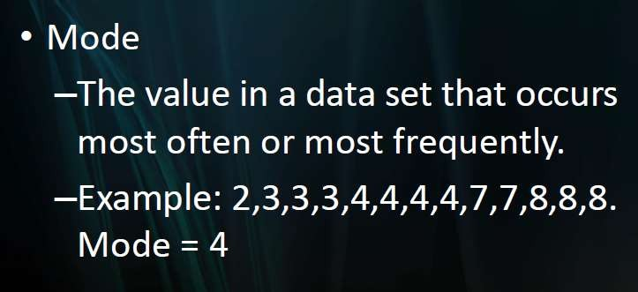

Slide 25
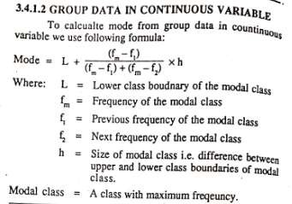

Slide 26
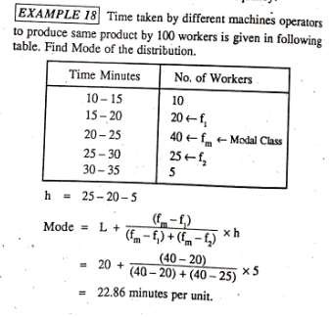

Slide 27
The mean is best when data is symmetrically distributed (not heavily skewed) and there are no extreme outliers, as these can distort the average.
The median is useful when dealing with skewed data (distributions with outliers) because it is not sensitive to extreme values.
MODE Use when you are interested in the most frequent occurrence, especially with categorical data or multimodal distributions.

Slide 28
Measure of variability
A measure of variability (or spread) is essential in statistics because it provides insight into how data points differ from one another and from the central tendency (like the mean or median). Here’s why it’s important:
Understanding Data Distribution: Variability indicates whether data points are close to the mean (low variability) or spread out (high variability). This helps in interpreting the data's overall structure.
Comparing Datasets: Measures like range, variance, and standard deviation allow comparisons between different datasets. For instance, if two datasets have similar means but different variabilities, they represent different distribution

Slide 29
Predicting Reliability: Low variability suggests that data points are consistent, which can imply reliability. High variability, on the other hand, might indicate greater uncertainty or fluctuations in data.

Slide 30
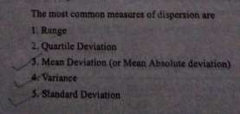

Slide 31
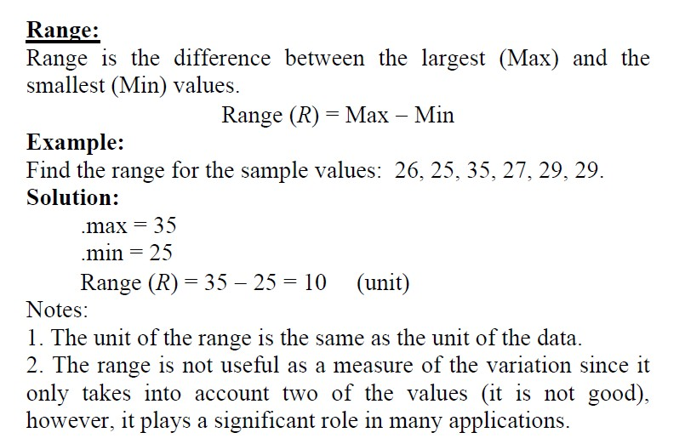

Slide 32
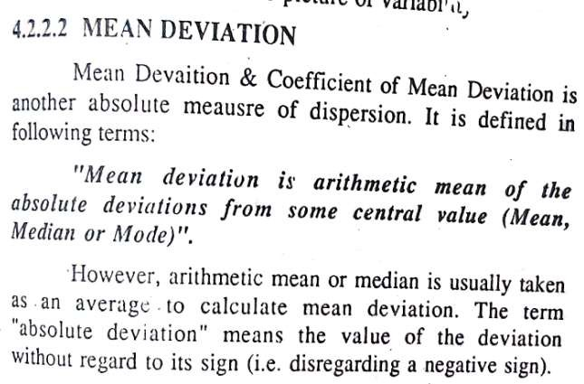

Slide 33
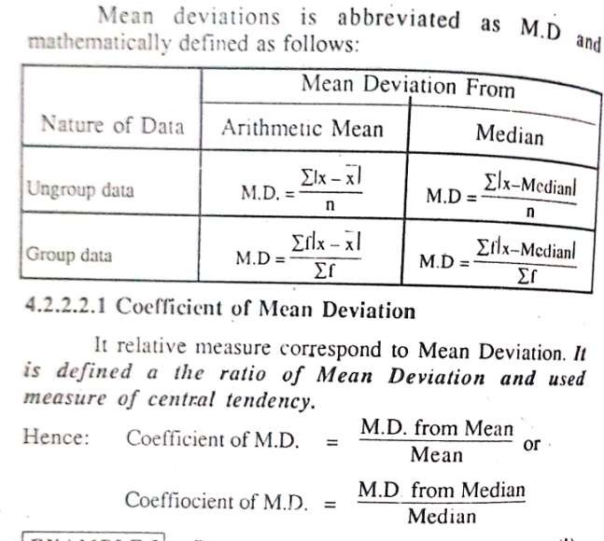

Slide 34
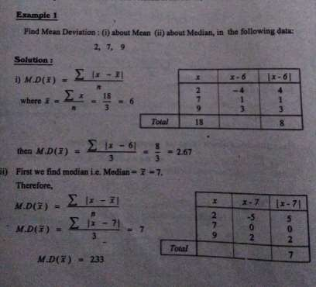

Slide 35
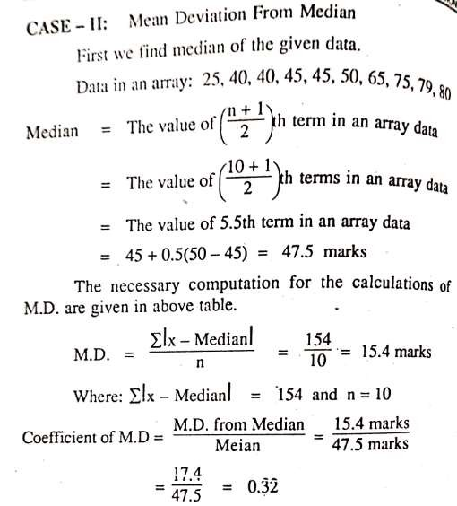

Slide 37
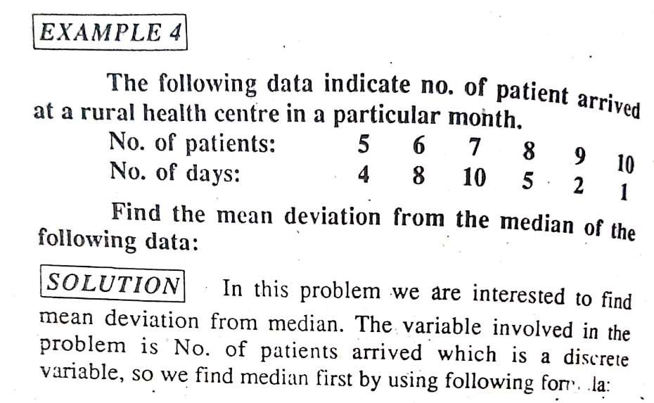

Slide 38
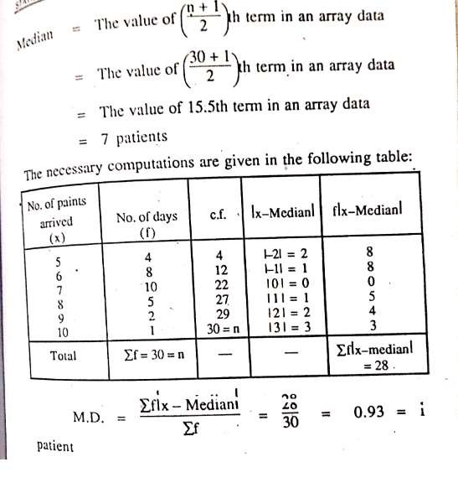

Slide 39
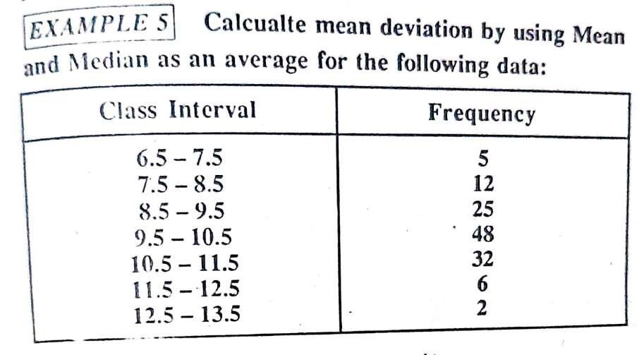

Slide 40
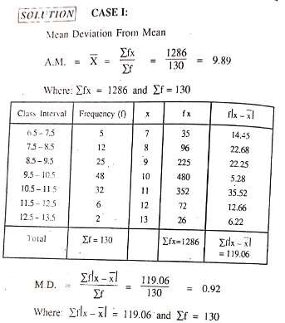

Slide 41
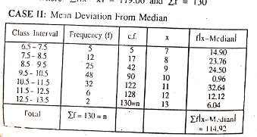

Slide 42
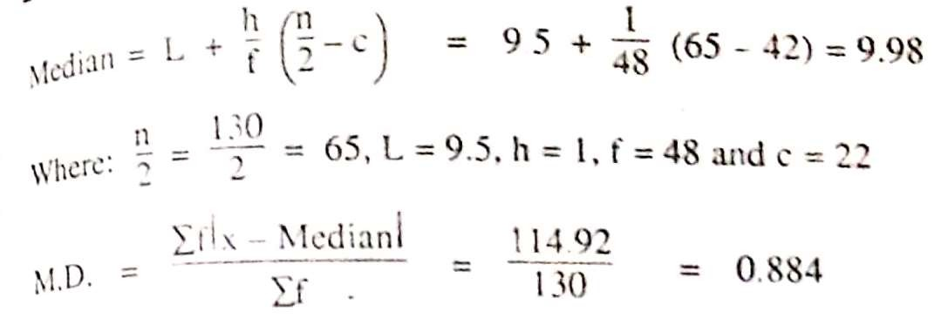

Slide 43
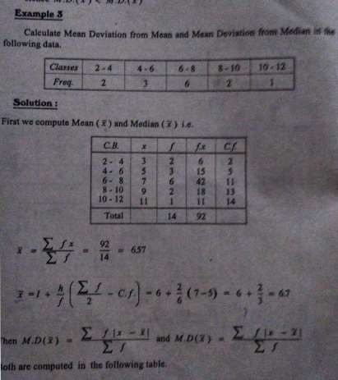

Slide 44
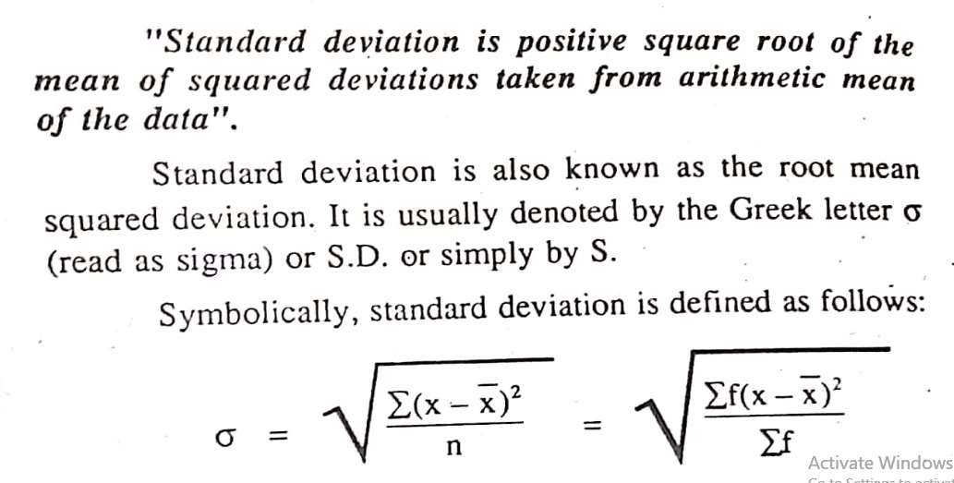

Slide 45
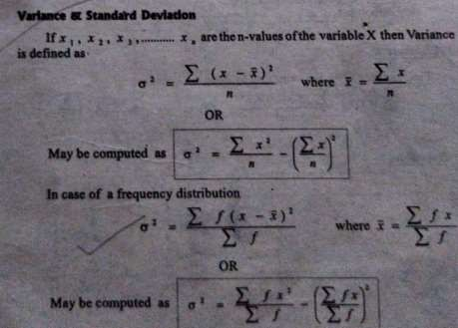

Slide 46
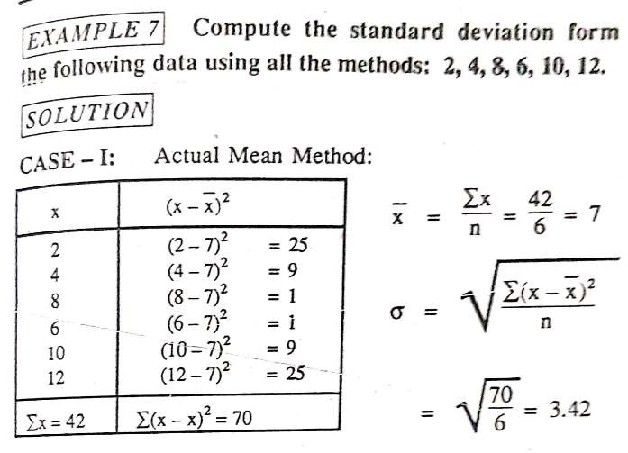

Slide 47
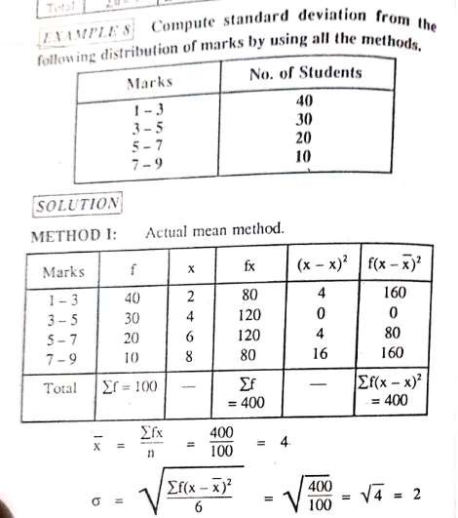

Slide 50
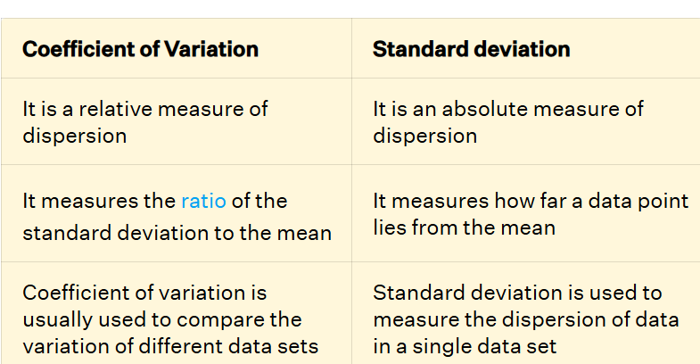

Slide 51
If two data sets having similar values need to be compared then the standard deviation can be used. However, if two data sets having different unit need to be compared then the coefficient of variation needs to be used

Slide 52
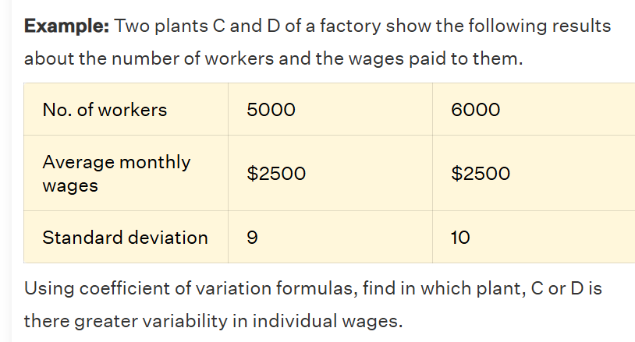

Slide 53
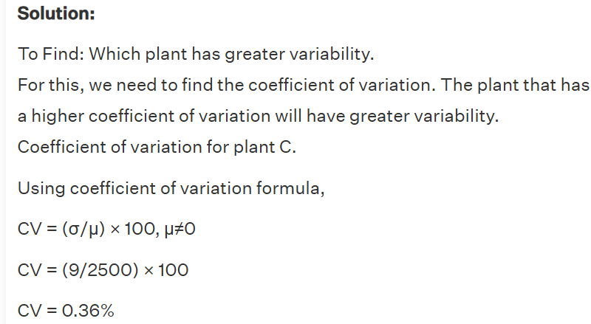

Slide 54
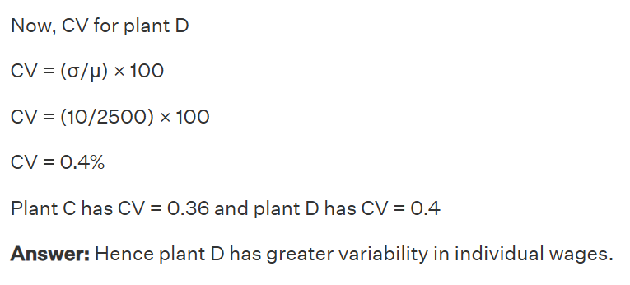

Slide 55
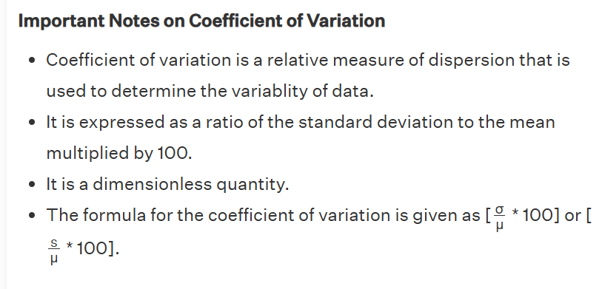

Slide 56
